Slide 1
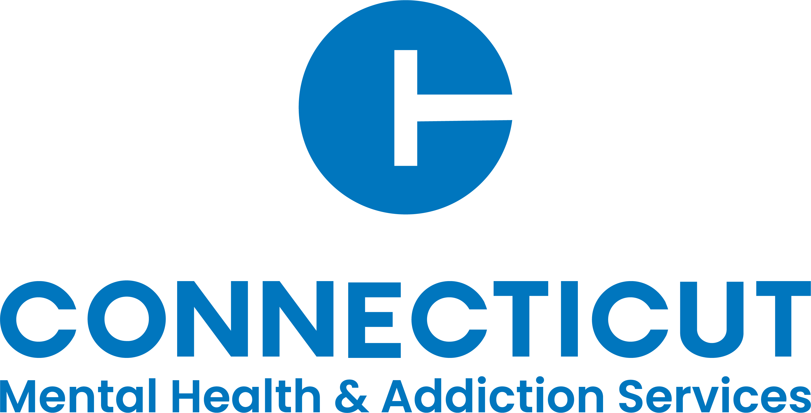

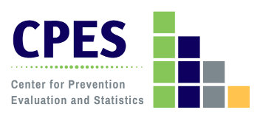
Connecticut Substance Use Prevention Resource Assessment:
Results and Resources
SEOW Meeting
December 18, 2024
Notes:
Substance use continues to pose a significant public health challenge in Connecticut.
Understanding the current landscape of these prevention efforts is crucial for identifying gaps, optimizing resource allocation, and ensuring that services are both equitable and effective. By assessing the availability and distribution of prevention resources, stakeholders can better tailor interventions to meet the specific needs of their populations.
In 2023, DMHAS, in collaboration with the Center for Prevention Evaluation and Statistics (CPES) at UConn Health, undertook a comprehensive statewide assessment of alcohol, tobacco, and other drug primary prevention resources, funded by the American Rescue Plan Act.
This assessment produced a publicly accessible, searchable electronic resource directory and interactive map cataloging prevention services by town, offering policymakers, healthcare providers, and community organizations a valuable tool for future planning and program development. This presentation will provide an overview of the methods and key findings, with a particular focus on primary prevention activities a the community (town) level.

Slide 2

Substance Use Prevention Resource Assessment: Objectives
Conduct a comprehensive community resource assessment of alcohol, tobacco, and other drug (ATOD) primary prevention programs and services provided within Connecticut.
Contribute to understanding (1) strengths that can be mobilized, used to fuller capacity, and built upon and (2) gaps, barriers, and needs to be addressed.
Develop resources for use by prevention partners and others at the state, regional, and local levels.

Slide 3

Target Audience
State Level | Substate Level | Community Level
State Agency Planners Policy Makers (i.e., Legislators) | Regional Behavioral Health Action Organizations Local Health Departments/ Districts Prevention Providers Resource Links | Prevention Coalitions Local Prevention Councils Youth Service Bureaus Local Evaluators Town/City Government

Slide 4
Methods

Slide 5
Data Sources
Web scan of state and substate level ATOD primary prevention services
Review of Connecticut’s 211 service call resources
Surveys of Regional Behavioral Health Action Organizations (RBHAO) and Local Prevention Councils (LPC)
Types of prevention strategies being implemented
Population served and setting for each strategy
Funding sources
Partnerships
Notes:
Data collection involved multiple sources.
In Connecticut, there are several key entities are responsible for coordinating and delivering substance use prevention services operating at the state, regional, and local levels. Our data collection strategy was designed to elicit what is happening at each of these level.
Survey data were collected from RBHAOs and LPCs from August-December 2023.
Supplemental data was collected January-March 2024.

Slide 6
LPC Survey Response Representation by Region
Region​ | LPC​ Responses​ | Total​ LPCs​ | LPC​ %​ | Towns ​ Represented​ | Total​ Towns​ | Town​ %​
1 ​ (Southwest)​ | 13​ | 14​ | 93%​ | 13​ | 14​ | 93%​
2​ (South Central)​ | 25​ | 28​ | 89%​ | 31​ | 34​ | 91%​
3​ (Eastern)​ | 19​ | 28​ | 68%​ | 24​ | 41​ | 59%​
4 ​ (North Central)​ | 28​ | 35​ | 80%​ | 30​ | 37​ | 81%​
5​ (Western)​ | 17​ | 21​ | 81%​ | 34​ | 43​ | 79%​
TOTAL​ | 102​ | 126​ | 81%​ | 132​ | 169​ | 78%​

Slide 7
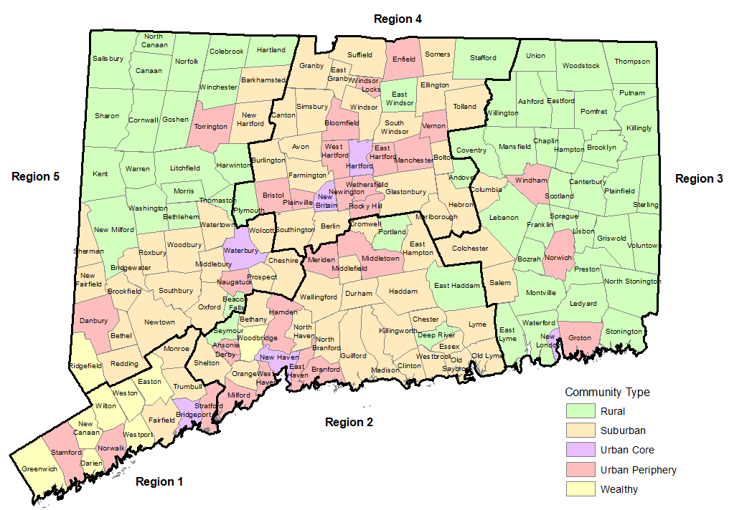
Analysis
Analysis of data was conducted statewide by town (n=169), as well as by DHMAS region and community type (rural, suburban, urban, and wealthy) using the Five Connecticuts typology.

Slide 8
Strengths
Statewide view of prevention landscape.
Triangulation of data.
  Use of multi-method approaches and sources.
Strong relationship between the lead agency (CPES) and CT ATOD prevention program and service agencies helped to obtain a 100% response rate for the RBHAO survey and an 81% response rate for the LPC survey.
Outreach efforts resulted in most to date contact information for LPCs, which can be shared with prevention partners.
Limitations
Missing prevention strategy data for some towns, especially those with smaller or more isolated communities and those with fewer prevention resources.
  These gaps may result in underestimations of prevention resources or may reflect limited capacity in some areas.
Cross-sectional nature of the survey data
  LPC prevention programs and services and are dependent on DMHAS funding and by a voluntary funding application process.
  Findings from the LPC survey represent a single point-in-time (Aug-Dec 2023) and are subject to change over time, especially for towns with no other funding sources.

Slide 9
Prevention Strategies
Information Dissemination: printed or electronic materials dissemination, health fairs
Material Distribution: Narcan, lock boxes, drug disposal, etc. Does NOT include promotional merchandise. (RBHAO survey only)
Education: speaking engagements, educational events, info sessions, PSAs
Alternative Programming: ATOD free-social/recreational events, community service activities
Social Marketing: media campaigns
Program Identification and Referral: student assistance programs, ASBIRT/SBIRT
Enforcement of Laws and Policies/Preventing Sales to Underage Youth: compliance checks, zoning enforcement
Public Policy Efforts: advocacy to change laws and policies
Funding of Prevention Efforts: providing funding to other agencies/organizations for prevention strategies and activities (RBHAO survey only)
Community Assessments/Data Collection*: needs assessment, community surveys, school surveys
Community-Based Processes*: coalition meetings, workgroups, community team meetings/activities
*Indirect service types
Notes:
Primary prevention resources were categorized by prevention strategy, target population served, implementation setting, and funding source.

Slide 10
Key Findings

Slide 11

State-Level: DHMAS Resource Links
Organization | Core Functions | Prevention Target Population(s) | Settings
Department of Mental Health and Addiction Services – Prevention and Health Promotion Division (DMHAS PHP) | Substance Use Prevention Health Promotion | Youth Young Adults Adults | Clinic Community Online
DMHAS Center for Prevention Evaluation and Statistics (CPES) at UConn Health | Evaluation Data Collection and Dissemination Data Capacity Building | Young Adults Adults | Community Online
CT Clearinghouse | Information Dissemination Education Social Marketing | Young Adults Adults | Community Online
Governor’s Prevention Partnership (GPP) | Youth Empowerment Mentoring | Youth Adults | Community Online
State Education Resource Center (SERC) | Prevention Curriculum DEI/Cultural Competency | Youth Adults | Community School Online
Prevention Training and Technical Assistance Service Center (TTASC) | Training/TA Workforce Development | Adults | Community Online
Notes:
Snapshot of statewide prevention resources.
As the single state agency for substance use prevention, DMHAS’ statewide prevention infrastructure is supported by its funded Resource Links.
Prevention activities are being implemented at a state-level across the lifespan.
Most activities are happening in community settings and online platforms. The State Education Resource Center is also working in schools and, DHMAS also is engaged in primary prevention in clinical/provider settings.

Slide 12
Organization | Strategy Types
 | Information Dissemination | Education | Community-Based Processes | Alternative Programming | Social Marketing | Program ID and Referral | Community Assessments/ Data Collection | Enforcement of Laws and Policies | Public Policy Efforts | Administer Funding for Prevention Efforts
Department of Mental Health and Addiction Services – Prevention and Health Promotion Division (DMHAS PHP) | ✅ | ✅ | ✅ | ✅ | ✅ | ✅ | ✅ | ✅ |  | ✅
DMHAS Center for Prevention Evaluation and Statistics (CPES) at UConn Health | ✅ | ✅ | ✅ |  |  |  | ✅
CT Clearinghouse | ✅ | ✅ | ✅ |  | ✅ |  |  |  |  | ✅
Governor’s Prevention Partnership (GPP) |  | ✅ | ✅ | ✅ |  |  | ✅ |  | ✅ | ✅
State Education Resource Center (SERC) | ✅ | ✅ | ✅ |  |  |  | ✅
Prevention Training and Technical Assistance Service Center (TTASC) | ✅ | ✅ | ✅ |  |  |  | ✅ |  |  | ✅
Notes:
These organizations are employing a broad range of prevention strategies.

Slide 13
Regional Level: RBHAOs
Region | Prevention Strategy RBHAO Survey Reporting
 | Information Dissemination | Material Distribution | Education | Alternative Programming | Social Marketing | Program ID & Referral | Law Enforcement | Public Policy Efforts | Funding of Prevention Efforts* | Community-Based Processes | Community Assessments
1 | ✅ | ✅ | ✅ |  | ✅ |  | ✅ | ✅ | ✅ | ✅ | ✅
2 | ✅ | ✅ | ✅ |  | ✅ | ✅ | ✅ | ✅ | ✅ | ✅ | ✅
3 | ✅ | ✅ | ✅ |  | ✅ |  |  | ✅ | ✅ | ✅ | ✅
4 | ✅ | ✅ | ✅ |  | ✅ |  | ✅ | ✅ | ✅ | ✅ | ✅
5 | ✅ | ✅ | ✅ |  | ✅ |  |  | ✅ | ✅ | ✅ | ✅
*Indirect services types
Notes:
At the regional level, all five RBHAOs are also implementing a broad range of primary prevention strategies.
Although none of the RBHAOs report the implementation of Alternative Programming (ATOD free-social/recreational events, community service activities), as you saw in the prior slide, and will see in a minute, this is happening at the state and community level.

Slide 14
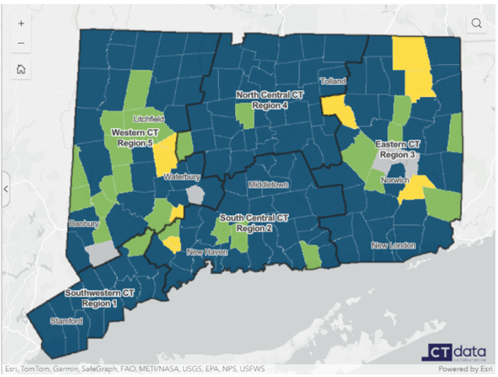
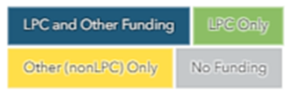
Community-Level:
Funding
Sources
Notes:
Most towns (92%) receive LPC grant funding for ATOD primary prevention programs and services, and 77% have at least one additional source of funding.
LPC funding coverage is complete (100%) in Regions 1 and 4, followed by 94% in Region 2, 88% in Region 5, and 83% in Region 3.
LPC funding ranges from 100% in wealthy towns to 85% in rural areas.
A higher proportion of towns in Regions 1, 2, and 4 report having multiple sources of prevention funding compared to Regions 3 and 5.
Urban towns are more likely to have multiple funding sources, while rural towns are more dependent on a single source, with 74% relying solely on LPC funding.
Five towns (3%) in Connecticut were not supported by any prevention funding as of 2023.
Region 3 (7%) and Region 5 (5%) have the highest proportion of towns without primary prevention funding.
Rural towns have the highest percentage of towns without funding (5%), followed by suburban towns (3%).

Slide 15
Funding Source | State | Region |  |  |  |  | Community Type
 | CT (169) | 1 (14) | 2 (34) | 3 (41) | 4 (37) | 5 (43) | Rural (60) | Suburban (64) | Urban (36) | Wealthy (9)
LPC | 155 (92%) | 14 (100%) | 32 (94%) | 34 (83%) | 37 (100%) | 38 (88%) | 51 (85%) | 61 (95%) | 34 (94%) | 9 (100%)
PCC | 12 (7%) | 0 (0%) | 4 (12%) | 3 (7%) | 3 (8%) | 2 (5%) | 2 (3%) | 6 (9%) | 4 (11%) | 0 (0%)
PFS (2022) | 12 (7%) | 1 (7%) | 3 (9%) | 3 (7%) | 3 (8%) | 2 (5%) | 5 (8%) | 2 (3%) | 5 (14%) | 0 (0%)
SPF-PFS | 5 (3%) | 0 (0%) | 5 (15%) | 0 (0%) | 0 (0%) | 0 (0%) | 0 (0%) | 2 (3%) | 2 (6%) | 1 (11%)
STOP | 6 (4%) | 1 (7%) | 4 (12%) | 0 (0%) | 0 (0%) | 1 (2%) | 2 (3%) | 3 (5%) | 1 (3%) | 0 (0%)
DFC | 24 (14%) | 7 (50%) | 3 (9%) | 5 (12%) | 5 (14%) | 4 (9%) | 1 (2%) | 8 (13%) | 12 (33%) | 3 (33%)
YSB | 133 (79%) | 12 (86%) | 29 (85%) | 30 (73%) | 34 (92%) | 28 (65%) | 42 (70%) | 49 (77%) | 34 (94%) | 8 (89%)
Funding Source | State | Region |  |  |  |  | Community Type
 | CT (169) | 1 (14) | 2 (34) | 3 (41) | 4 (37) | 5 (43) | Rural (60) | Suburban (64) | Urban (36) | Wealthy (9)
No funding | 5 (3%) | 0 (0%) | 0 (0%) | 3 (7%) | 0 (0%) | 2 (5%) | 3 (5%) | 2 (3%) | 0 (0%) | 0 (0%)
LPC only | 25 (15%) | 2 (14%) | 4 (12%) | 6 (15%) | 2 (5%) | 12 (28%) | 13 (22%) | 11 (17%) | 1 (3%) | 1 (11%)
Non-LPC funding only | 9 (5%) | 0 (0%) | 2 (6%) | 4 (10%) | 0 (0%) | 3 (7%) | 6 (10%) | 1 (2%) | 2 (6%) | 0 (0%)
LPC + 1 or more other | 130 (77%) | 12 (86%) | 28 (82%) | 28 (68%) | 35 (95%) | 26 (60%) | 38 (63%) | 50 (78%) | 33 (92%) | 8 (89%)

Slide 16
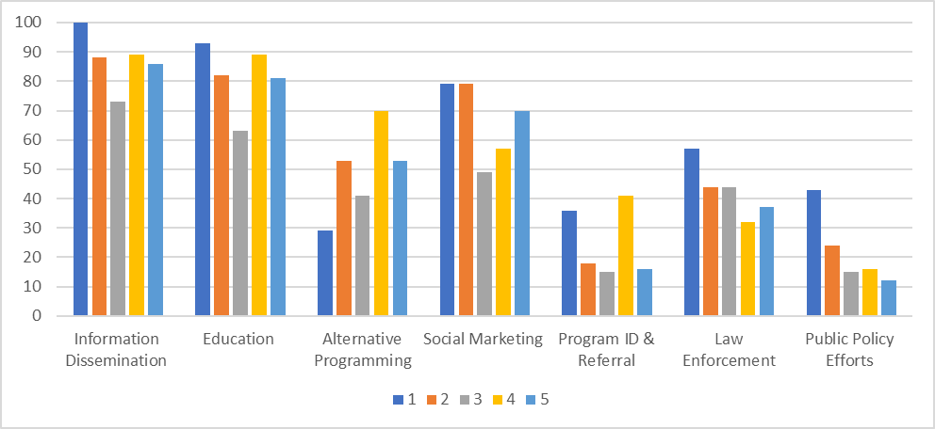
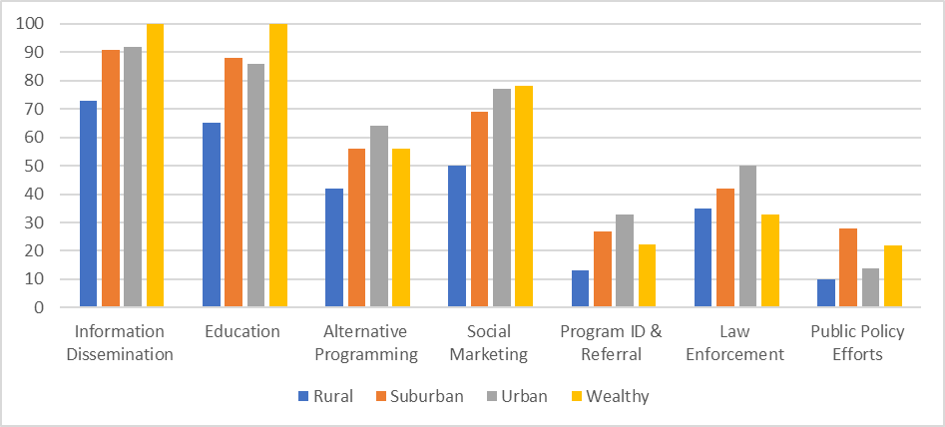
Community-Based Initiatives by Region and Community Type
Notes:
Proportion of Towns Implementing Each Prevention Strategy by Region and Community Type
The most commonly implemented primary prevention strategies across Connecticut towns are Information Dissemination (85%), Education (80%), and Social Marketing (64%).
Indirect service types like Community-Based Processes (79%) and Community Assessments (61%) are also widely used.
Approximately 53% of towns implement Alternative Programming, with Region 4 and urban areas having the highest participation rates.
There is significant regional variation in the implementation of prevention strategies.
Region 1 shows the highest reported implementation across most strategies, while Region 3 has the lowest implementation rates.
Rural towns report the lowest levels of implementation across all prevention strategies compared to suburban, urban, and wealthy towns.
Lower response rates to the LPC survey in rural towns and in Region 3 may also reflect capacity or resource issues in those areas.

Slide 17
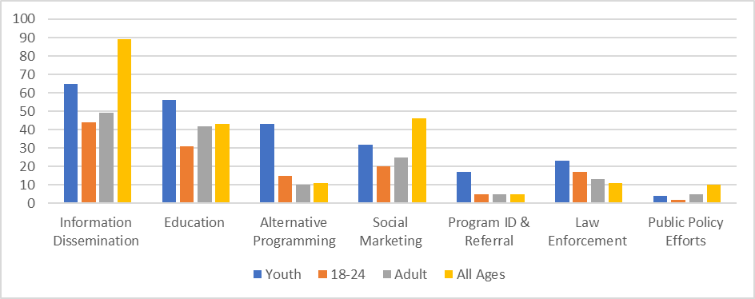
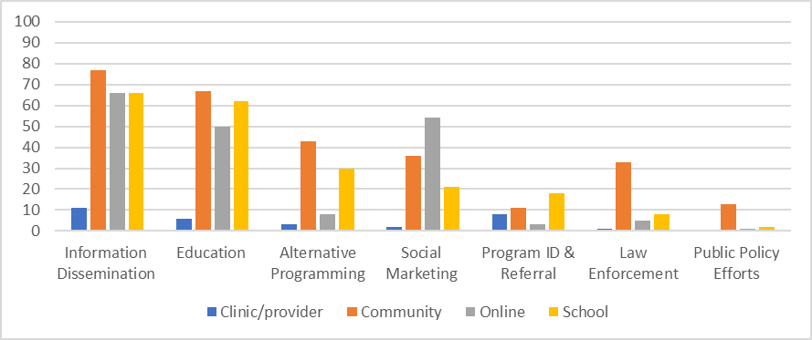
Community-Based Initiatives by Population and Setting
Notes:
Populations Served by Towns Implementing Each Prevention Strategy
Settings in Which Towns are Implementing Each Prevention Strategy
Youth-Centered Focus: Connecticut's primary substance use prevention infrastructure is focused on youth populations, with some inclusion of other age groups across the lifespan.
Information dissemination, education, social marketing, community-based processes exhibit the broadest reach across all age groups.
Predominant Settings: Most prevention strategies occur within community and school settings, except for social marketing, which is primarily implemented online.
Multiple Settings for Most Strategies: Most prevention strategies are implemented in more than one setting, although the degree of implementation varies.
Limited Use in Clinical Settings: Few prevention strategies are taking place in clinical or provider-based settings, indicating an area for potential expansion.

Slide 18
Conclusions
Multi-Strategy Approach: Connecticut employs a comprehensive strategy for substance use prevention, combining information dissemination, education, social marketing, and community-based initiatives, with a strong emphasis on outreach to youth in both community and school settings.
Regional Tailoring of Efforts: The involvement of Regional Behavioral Health Action Organizations (RBHAOs) and Local Prevention Councils (LPCs) allows for prevention efforts to be customized according to local community needs and contexts, ensuring relevance and effectiveness.
Funding Disparities and Community Capacity: There are notable disparities in funding and implementation across different regions, with some areas lacking resources. Community capacity and readiness to engage in substance use prevention significantly influence these disparities, affecting their ability to plan and execute effective initiatives.
Integration of Healthcare Providers: There is a missed opportunity to enhance primary prevention efforts through better integration of clinical settings and healthcare providers, which could help engage populations that may not participate in traditional community or school-based programs.

Slide 19

Final Products
Summary of findings
Electronic resource directory
Interactive resource map
Explore these and other resources on the
SEOW Prevention Data Portal

Slide 20
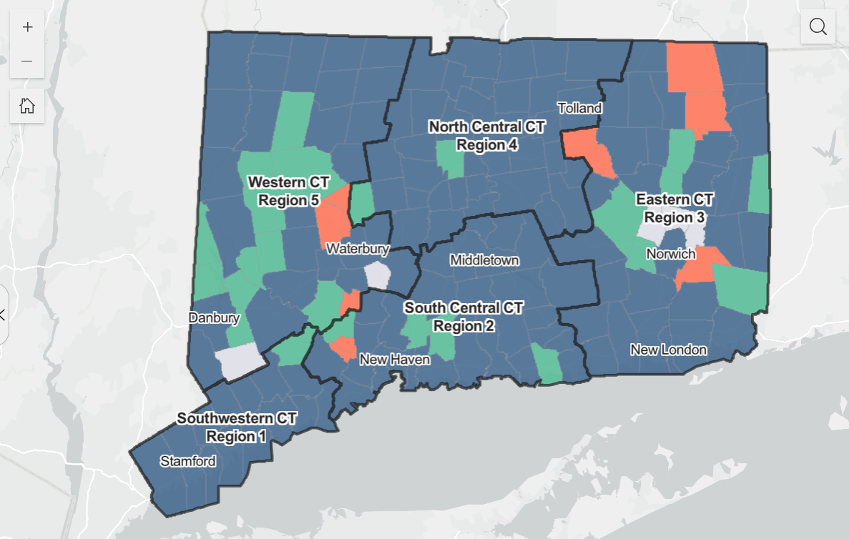
Connecticut Substance Use Prevention
Resources: An Interactive Map
Use map filters to explore:
Funding type
Prevention strategies
Overlay community type
Hover over towns to see town-level contact, funding, and strategy information
CPES Prevention Resource Assessment Map — SEOW Prevention Data Portal

Slide 21

Questions? Opportunities?

Slide 22
Thank you
Explore prevention resource assessment products on the
SEOW Prevention Data Portal
DMHAS Center for Prevention Evaluation and Statistics (CPES) at UConn Health
Contacts: Jennifer Sussman: sussman@uchc.edu
Megan O’Grady: ogrady@uchc.edu

